Slide 1

Database Systems: Design, Implementation, and Management
Chapter 1
Database Systems
Last Revision: 23.09.2022

Slide 2
Objectives
In this chapter, you will learn:
The difference between data and information
What a database is, the various types of databases, and why they are valuable assets for decision making
The importance of database design
How modern databases evolved from file systems

Slide 3
Objectives (cont’d.)
About flaws in file system data management
The main components of the database system
The main functions of a database management system (DBMS)

Slide 4
Introduction
Good decisions require good information derived from raw facts
Data is managed most efficiently when stored in a database
Databases evolved from computer file systems
Understanding file system characteristics is important

Slide 5
Why Databases?
Databases solve many of the problems encountered in data management
Used in almost all modern settings involving data management:
Business
Research
Administration
Important to understand how databases work and interact with other applications

Slide 6
Data vs. Information
Data are raw facts
Information is the result of processing raw data to reveal meaning
Information requires context to reveal meaning
Raw data must be formatted for storage, processing, and presentation
Data are the foundation of information, which is the bedrock of knowledge
Knowledge The body of information and facts about a specific subject. Knowledge implies familiarity, awareness, and understanding of information as it applies to an environment. A key characteristic is that new knowledge can be derived from old knowledge.

Slide 7
Data vs. Information (cont’d.)
Data: building blocks of information
Information produced by processing data
Information used to reveal meaning in data
Accurate, relevant, timely information is the key to good decision making
Good decision making is the key to organizational survival

Slide 8
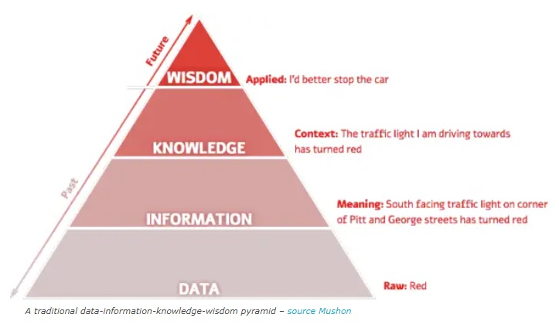
Data-Information-Knowledge-Wisdom
Source: https://www.i-scoop.eu/big-data-action-value-context/dikw-model/
Visited: 23.09.2022

Slide 9
Introducing the Database
Database: shared, integrated computer structure that stores a collection of:
End-user data: raw facts of interest to end user
Metadata: data about data
Provides description of data characteristics and relationships in data
Complements and expands value of data
Database management system (DBMS): collection of programs
Manages structure and controls access to data

Slide 10
Role and Advantages of the DBMS
DBMS is the intermediary between the user and the database
Database structure stored as file collection
Can only access files through the DBMS
DBMS enables data to be shared
DBMS integrates many users’ views of the data

Slide 11
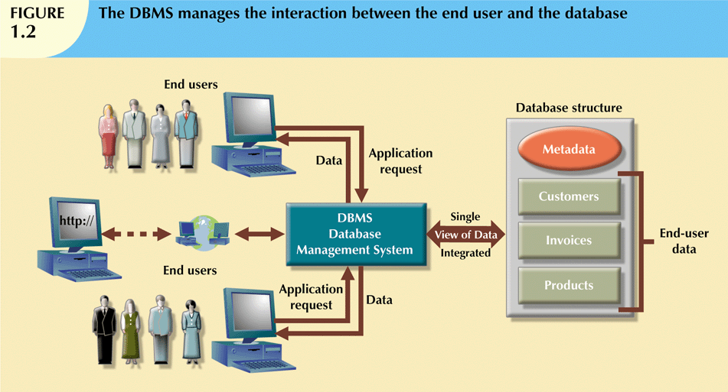

Slide 12
Role and Advantages of the DBMS (cont’d.)
Advantages of a DBMS:
Improved data sharing
Improved data security
Better data integration
Minimized data inconsistency
Improved data access
Improved decision making
Increased end-user productivity

Slide 13
Types of Databases
Databases can be classified according to:
Number of users
Database location(s)
Expected type and extent of use

Slide 14
Types of Database: Number of Users
Single-user database supports only one user at a time
Desktop database: single-user; runs on PC
Multiuser database supports multiple users at the same time
Workgroup and enterprise databases

Slide 15
Types of Databases: Database Locations
Centralized database: data located at a single site
Distributed database: data distributed across several different sites
Cloud database: created and maintained using cloud data services, such as Microsoft Azure or Amazon AWS.

Slide 16
Types of Databases: Expected type and extent of use
Operational database: supports a company’s day-to-day operations
Transactional or production database
Data warehouse: stores data used for tactical or strategic decisions.
Online analytical processing (OLAP) is a set of tools that work together to provide an advanced data analysis environment for retrieving, processing, and modeling data from the data warehouse.
The term business intelligence describes a comprehensive approach to capture and process business data with the purpose of generating information to support business decision making. Ch. 13

Slide 17
Types of Databases: Supported Data Types
Unstructured data exist in their original state
Structured data result from formatting
Structure applied based on type of processing to be performed
Semistructured data have been processed to some extent
Extensible Markup Language (XML) represents data elements in textual format
XML database supports semistructured XML data

Slide 18
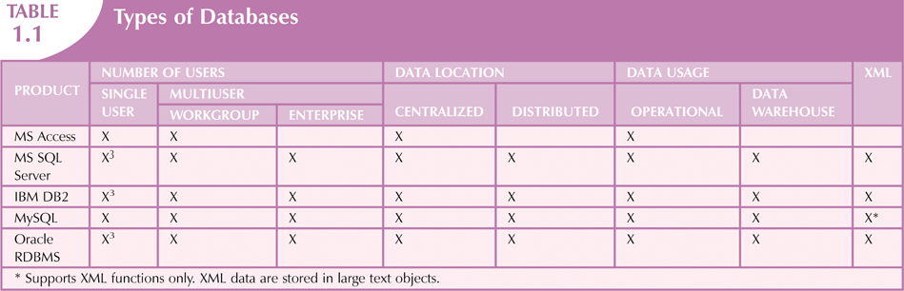

Slide 19
NoSQL
Not Only SQL
https://www.internetlivestats.com/
Designed to handle the unprecedented volume of data, variety of data types and structures, and velocity of data operations that are characteristic of these new business requirements.

Slide 20
Why Database Design Is Important
Database design focuses on design of database structure used for end-user data
Designer must identify database’s expected use
Well-designed database:
Facilitates data management
Generates accurate and valuable information
Poorly designed database:
Causes difficult-to-trace errors

Slide 21
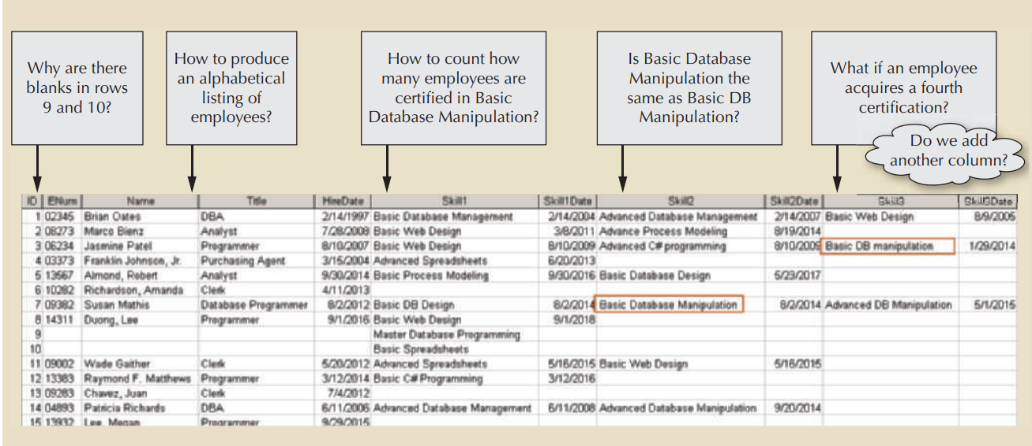
Bad Design

Slide 22
Evolution of File System Data Processing
Reasons for studying file systems:
Complexity of database design is easier to understand
Understanding file system problems helps to avoid problems with DBMS systems
Knowledge of file system is useful for converting file system to database system
File systems typically composed of collection of file folders, each tagged and kept in cabinet
Organized by expected use

Slide 23
Evolution of File System Data Processing (cont'd.)
Contents of each file folder are logically related
Manual systems
Served as a data repository for small data collections
Cumbersome for large collections
Computerized file systems
Data processing (DP) specialist converted computer file structure from manual system
Wrote software that managed the data
Designed the application programs

Slide 24
Evolution of File System Data Processing (cont'd.)
Initially, computer file systems resembled manual systems
As number of files increased, file systems evolved
Each file used its own application program to store, retrieve, and modify data
Each file was owned by individual or department that commissioned its creation

Slide 25
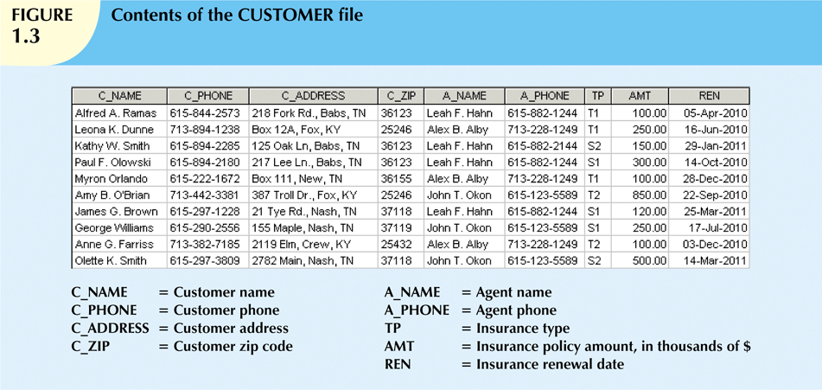

Slide 26
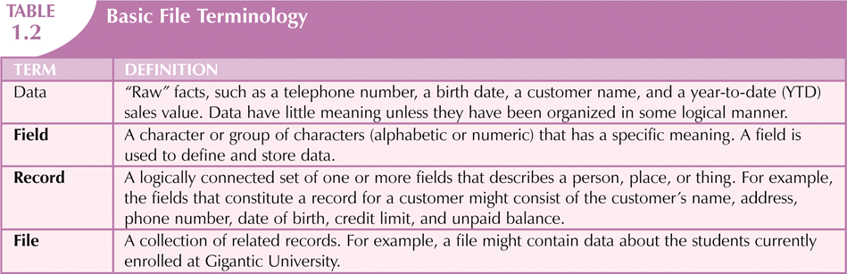

Slide 27
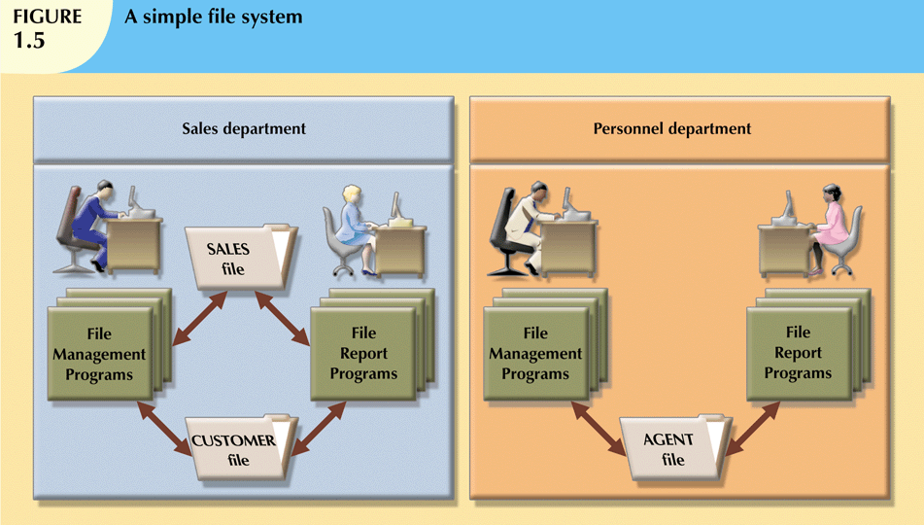

Slide 28
Problems with File System Data Processing
File systems were an improvement over manual system
File systems used for more than two decades
Understanding the shortcomings of file systems aids in development of modern databases
Many problems not unique to file systems
Even simple file system retrieval task required extensive programming
Ad hoc queries impossible
Changing existing structure difficult

Slide 29
Problems with File System Data Processing (cont'd.)
Security features difficult to program
Often omitted in file system environments
Summary of file system limitations:
Requires extensive programming
Cannot perform ad hoc queries
System administration is complex and difficult
Difficult to make changes to existing structures
Security features are likely to be inadequate

Slide 30
Structural and Data Dependence
Structural dependence: access to a file is dependent on its own structure
All file system programs must be modified to conform to a new file structure
Structural independence: change file structure without affecting data access
Data dependence: data access changes when data storage characteristics change
Data independence: data storage characteristics do not affect data access

Slide 31
Structural and Data Dependence (cont'd.)
Practical significance of data dependence is difference between logical and physical format
Logical data format: how human views the data
Physical data format: how computer must work with data
Each program must contain:
Lines specifying opening of specific file type
Record specification
Field definitions

Slide 32
Data Redundancy
File system structure makes it difficult to combine data from multiple sources
Vulnerable to security breaches
Organizational structure promotes storage of same data in different locations
Islands of information
Data stored in different locations is unlikely to be updated consistently
Data redundancy: same data stored unnecessarily in different places

Slide 33
Data Redundancy (cont'd.)
Data inconsistency: different and conflicting versions of same data occur at different places
Data anomalies: abnormalities when all changes in redundant data are not made correctly
Update anomalies
Insertion anomalies
Deletion anomalies

Slide 34
Lack of Design and Data-Modeling Skills
Most users lack the skill to properly design databases, despite multiple personal productivity tools being available
Data-modeling skills are vital in the data design process
Good data modeling facilitates communication between the designer, user, and the developer

Slide 35
Database Systems
Database system consists of logically related data stored in a single logical data repository
May be physically distributed among multiple storage facilities
DBMS eliminates most of file system’s problems
Current generation stores data structures, relationships between structures, and access paths
Also defines, stores, and manages all access paths and components

Slide 36
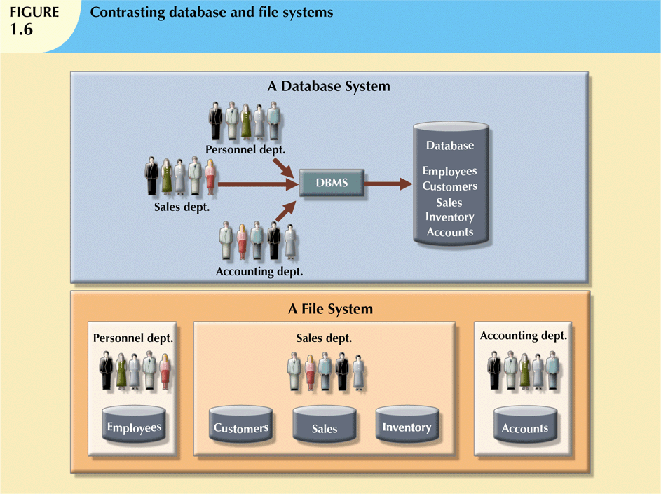

Slide 37
The Database System Environment
Database system: defines and regulates the collection, storage, management, use of data
Five major parts of a database system:
Hardware
Software
People
Procedures
Data

Slide 38
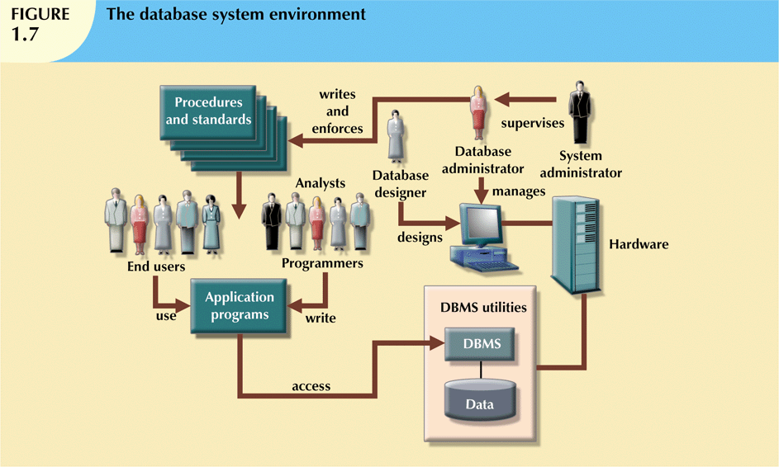

Slide 39
The Database System Environment (cont'd.)
Hardware: all the system’s physical devices
Software: three types of software required:
Operating system software
DBMS software
Application programs and utility software

Slide 40
The Database System Environment (cont'd.)
People: all users of the database system
System and database administrators
Database designers
Systems analysts and programmers
End users
Procedures: instructions and rules that govern the design and use of the database system
Data: the collection of facts stored in the database

Slide 41
The Database System Environment (cont'd.)
Database systems are created and managed at different levels of complexity
Database solutions must be cost-effective as well as tactically and strategically effective
Database technology already in use affects selection of a database system

Slide 42
DBMS Functions
Most functions are transparent to end users
Can only be achieved through the DBMS
Data dictionary management
DBMS stores definitions of data elements and relationships (metadata) in a data dictionary
DBMS looks up required data component structures and relationships
Changes automatically recorded in the dictionary
DBMS provides data abstraction and removes structural and data dependency

Slide 43
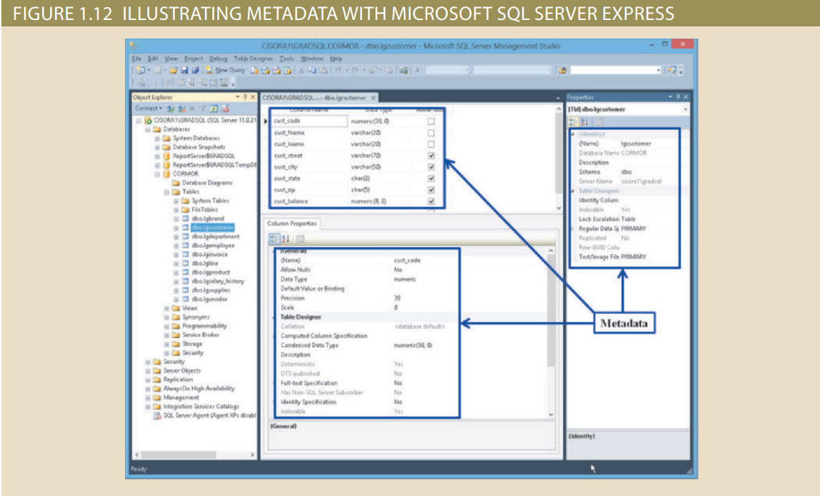

Slide 44
DBMS Functions (cont'd.)
Data storage management
DBMS creates and manages complex structures required for data storage
Also stores related data entry forms, screen definitions, report definitions, etc.
Performance tuning: activities that make the database perform more efficiently
DBMS stores the database in multiple physical data files

Slide 45
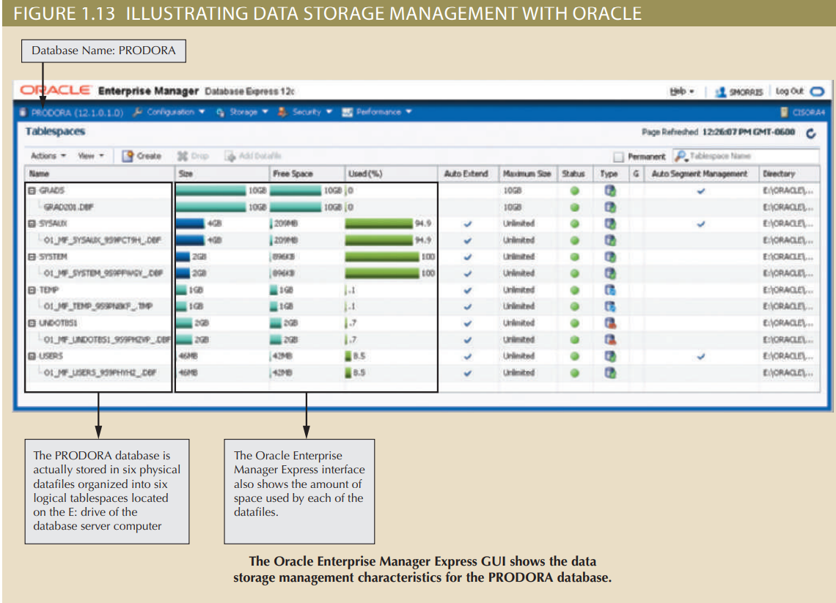

Slide 46
DBMS Functions (cont'd.)
Data transformation and presentation
DBMS transforms data entered to conform to required data structures
DBMS transforms physically retrieved data to conform to user’s logical expectations
Security management
DBMS creates a security system that enforces user security and data privacy
Security rules determine which users can access the database, which items can be accessed, etc.

Slide 47
DBMS Functions (cont'd.)
Multiuser access control
DBMS uses sophisticated algorithms to ensure concurrent access does not affect integrity
Backup and recovery management
DBMS provides backup and data recovery to ensure data safety and integrity
Recovery management deals with recovery of database after a failure
Critical to preserving database’s integrity

Slide 48
DBMS Functions (cont'd.)
Data integrity management
DBMS promotes and enforces integrity rules
Minimizes redundancy
Maximizes consistency
Data relationships stored in data dictionary used to enforce data integrity
Integrity is especially important in transaction-oriented database systems

Slide 49
DBMS Functions (cont'd.)
Database access languages and application programming interfaces
DBMS provides access through a query language
Query language is a nonprocedural language
Structured Query Language (SQL) is the de facto query language
Standard supported by majority of DBMS vendors

Slide 50
DBMS Functions (cont'd.)
Database communication interfaces
Current DBMSs accept end-user requests via multiple different network environments
Communications accomplished in several ways:
End users generate answers to queries by filling in screen forms through Web browser
DBMS automatically publishes predefined reports on a Web site
DBMS connects to third-party systems to distribute information via e-mail

Slide 51
Managing the Database System: A Shift in Focus
Database system provides a framework in which strict procedures and standards enforced
Role of human changes from programming to managing organization’s resources
Database system enables more sophisticated use of the data
Data structures created within the database and their relationships determine effectiveness

Slide 52
Managing the Database System: A Shift in Focus (cont'd.)
Disadvantages of database systems:
Increased costs
Management complexity
Maintaining currency(Keep system up to date cost, updating, personel trainging etc.)
Vendor dependence
Frequent upgrade/replacement cycles(Sometimes requires to update hardware also)

Slide 53
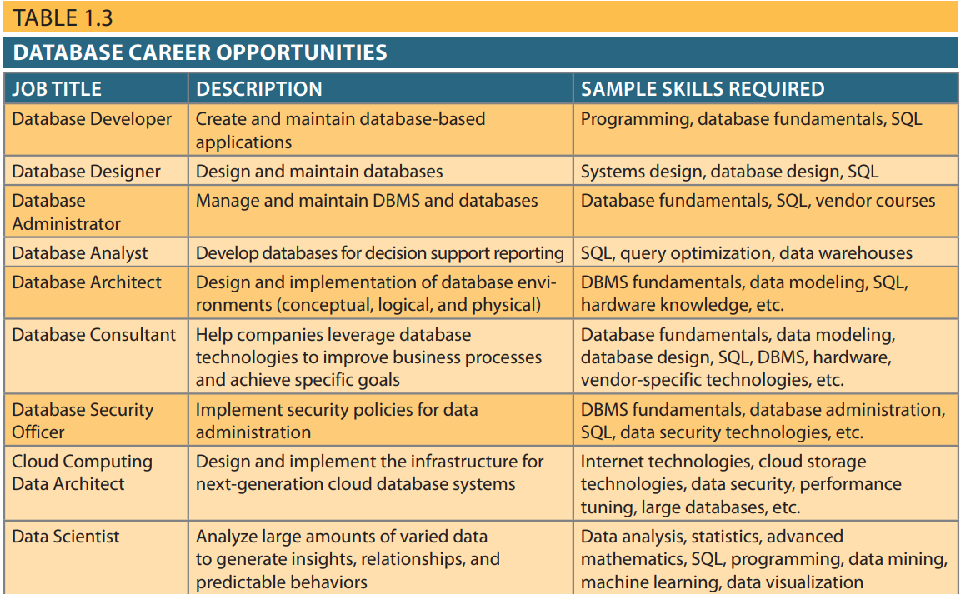

Slide 54
Cutting-edge, complex database technologies
Very large databases (VLDB). Many vendors are addressing the need for databases that support large amounts of data, usually in the petabyte range. (A petabyte is more than 1,000 terabytes.) VLDB vendors include Oracle Exadata, IBM’s Netezza, HP’s Vertica, and Teradata. VLDBs are now being superceded by Big Data databases.
Big Data databases. Products such as Cassandra (Facebook) and BigTable (Google) are using “columnar-database” technologies to support the needs of database applications that manage large amounts of “nontabular” data. See more about this topic in Chapter 2.
In-memory databases. Most major database vendors also offer some type of inmemory database support to address the need for faster database processing. In-memory databases store most of their data in primary memory (RAM) rather than in slower secondary storage (hard disks). In-memory databases include IBM’s solidDB and Oracle’s TimesTen.
Cloud databases. Companies can now use cloud database services to quickly add database systems to their environment while simultaneously lowering the total cost of ownership of a new DBMS. A cloud database offers all the advantages of a local DBMS, but instead of residing within your organization’s network infrastructure, it resides on the Internet. See more about this topic in Chapter 15.

Slide 55
Summary
Data are raw facts
Information is the result of processing data to reveal its meaning
Accurate, relevant, and timely information is the key to good decision making
Data are usually stored in a database
DBMS implements a database and manages its contents

Slide 56
Summary (cont'd.)
Metadata is data about data
Database design defines the database structure
Well-designed database facilitates data management and generates valuable information
Poorly designed database leads to bad decision making and organizational failure
Databases evolved from manual and computerized file systems

Slide 57
Summary (cont'd.)
In a file system, data stored in independent files
Each requires its own management program
Some limitations of file system data management:
Requires extensive programming
System administration is complex and difficult
Changing existing structures is difficult
Security features are likely inadequate
Independent files tend to contain redundant data
Structural and data dependency problems

Slide 58
Summary (cont'd.)
Database management systems were developed to address file system’s inherent weaknesses
DBMS present database to end user as single repository
Promotes data sharing
Eliminates islands of information
DBMS enforces data integrity, eliminates redundancy, and promotes security

